Slide 1
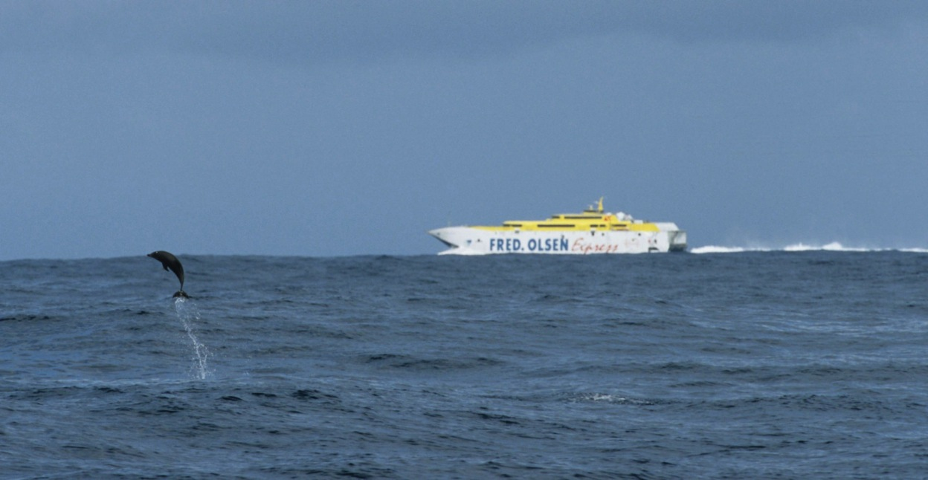
Collisions between vessels and cetaceans:
How to mitigate an issue with many unknowns
Notes:
(Intro suggestion)
First let me thank … for inviting me to this talk about this issue, which, as you will see, is of growing concern worldwide.
This is a collaborative presentation developed by the International Whaling Commission (IWC) and the German based NGO M.E.E.R.

Slide 2
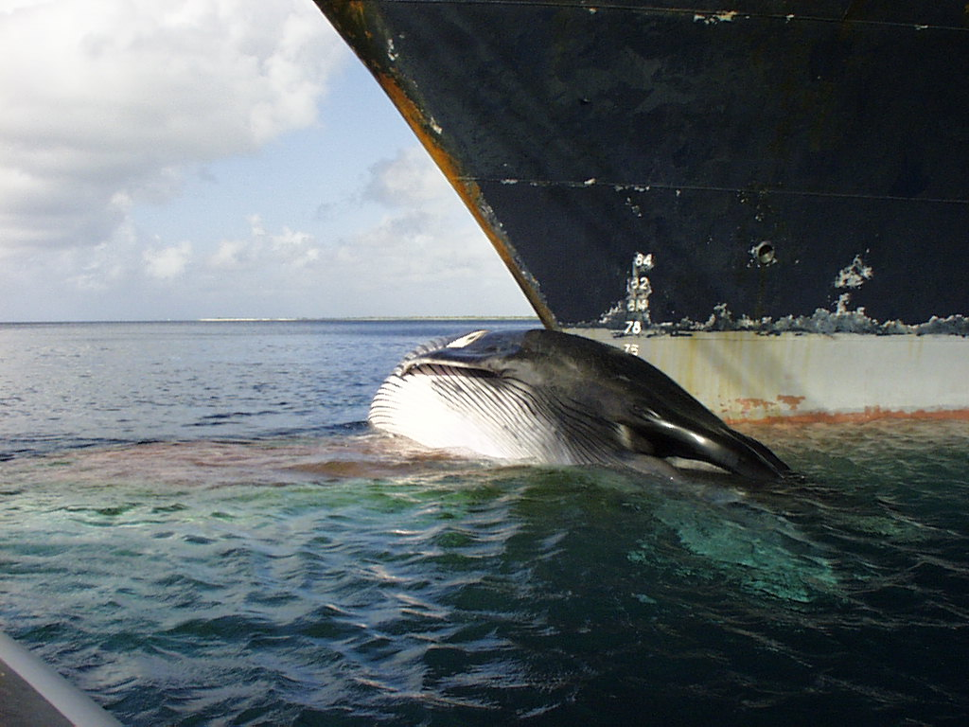
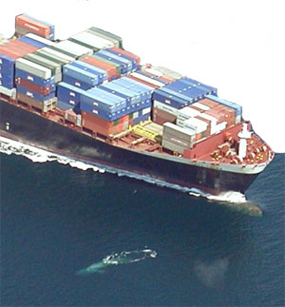
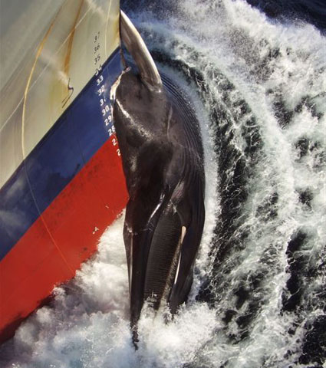
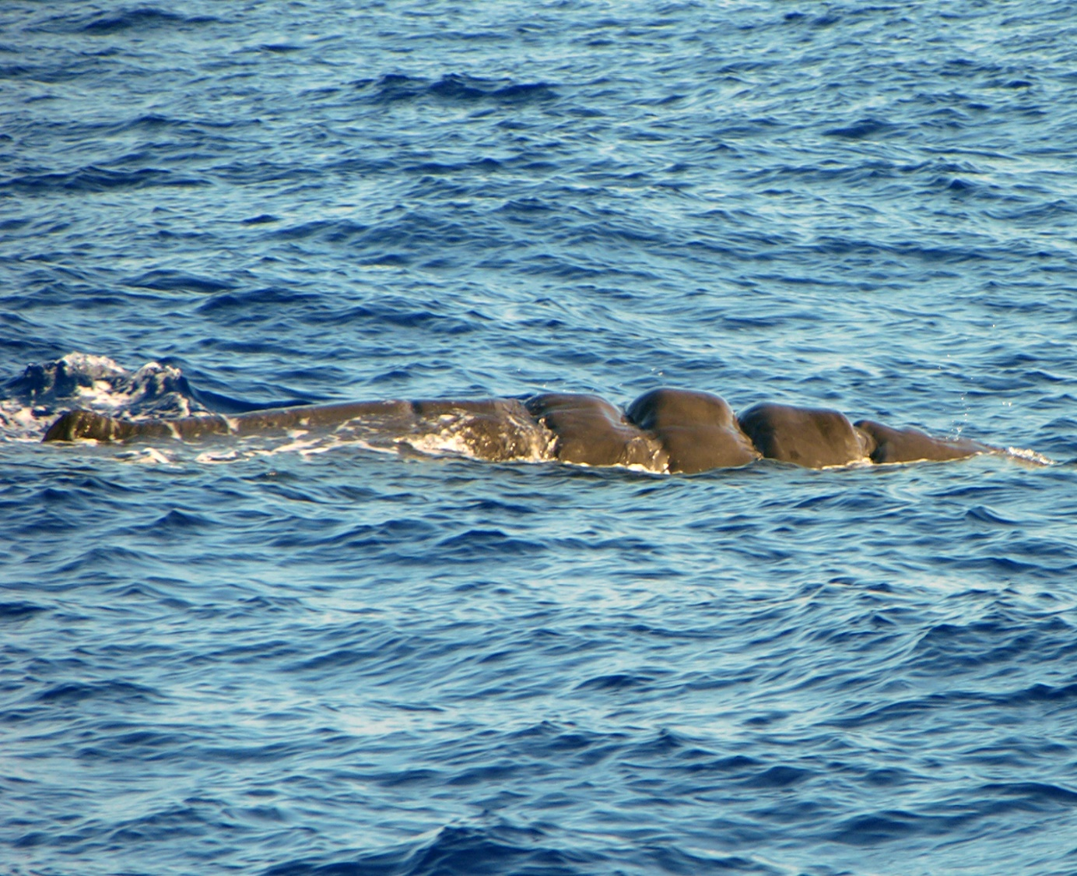
How do collisions occur?
© NOAA
© Friends of the Earth/Matsen
© Friends of the Earth/Matsen
© Simone Panigada/Tethys
© Bonaire National Marine Park
Introduction > Reasons & Causes > Mitigation Measures > IWC Data Base
Notes:
The worldwide number of collisions has significantly increased since the 1950s. During the past years, with a steep global increase of shipping traffic and increasing average travel speeds of vessels, the situation became - at least in some areas of the world – a real conservation problem, sometimes even a matter of survival for cetaceans on a population level.
Whales may be hit by the bow or the keel of a vessel, protruding parts of vessels like skegs or stabilizers, or by its propeller, leaving nasty wounds on a live animal. Sometimes whales are stuck on the bow of large ships and brought into the harbour. Such cases might only be recognized upon arrival at port.

Slide 3
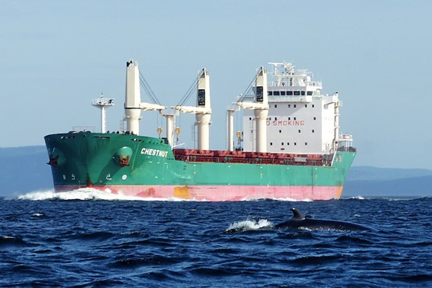
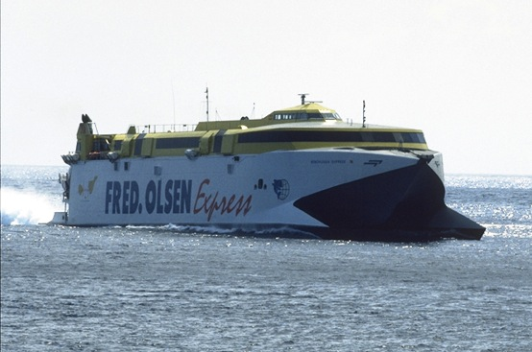
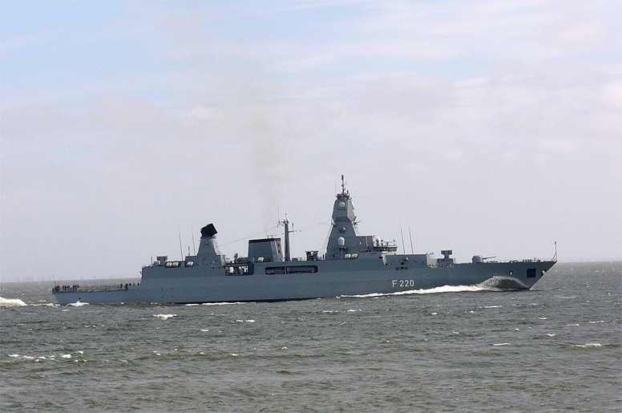
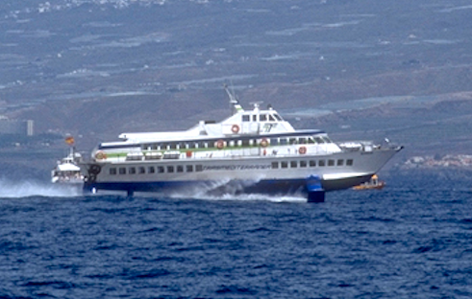
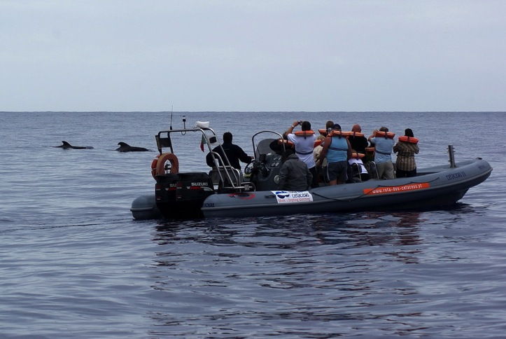
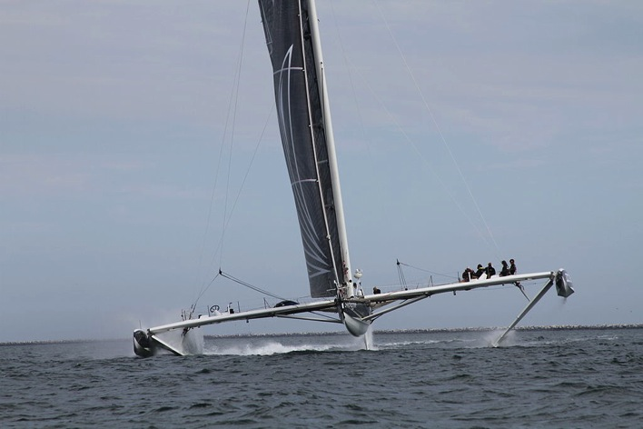
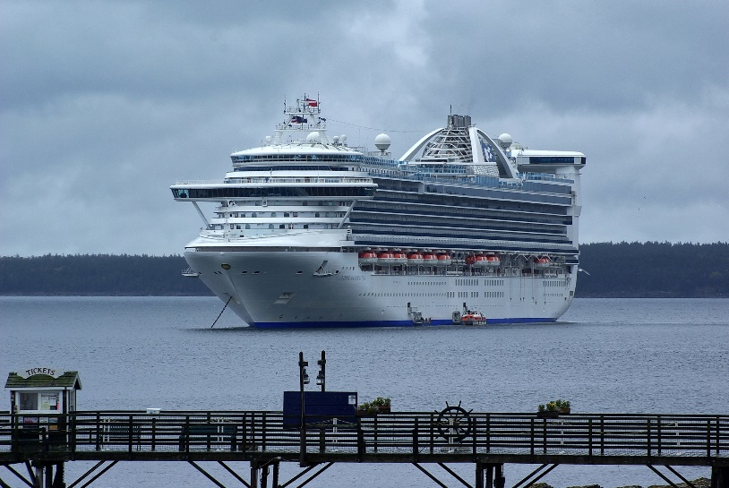
Vessel types involved
© F. Ritter / MEER e.V.
© Christiane Loch
© Andreas Trepte
© F. Ritter / MEER e.V.
© Fabian Ritter
© Thomas Lesage
© Fabian Ritter
Introduction > Reasons & Causes > Mitigation Measures > IWC Data Base
Notes:
Which vessel types are involved?
As cetaceans are animals that have to come to the surface to breathe, quite naturally every type of vessel can hit a whale or dolphin. All of the following have been reported to hit cetaceans: freighters, large ferries, high speed ferries, cruise ship, small boats, hydrofoils, navy vessels, whale watching boats and even sailors, especially those ones travelling at considerable speeds, for example during regattas & ocean races.

Slide 4
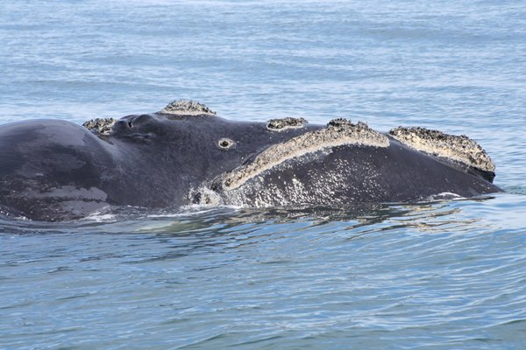
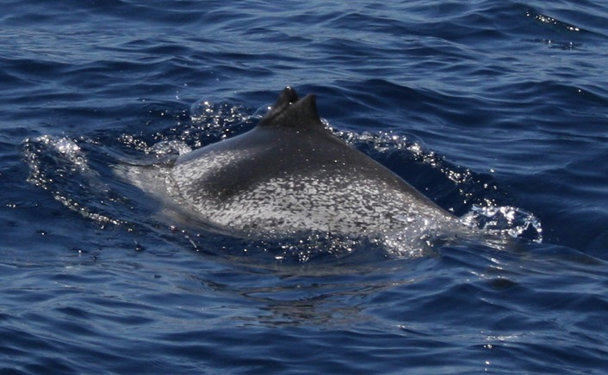
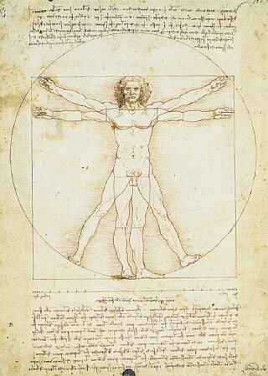
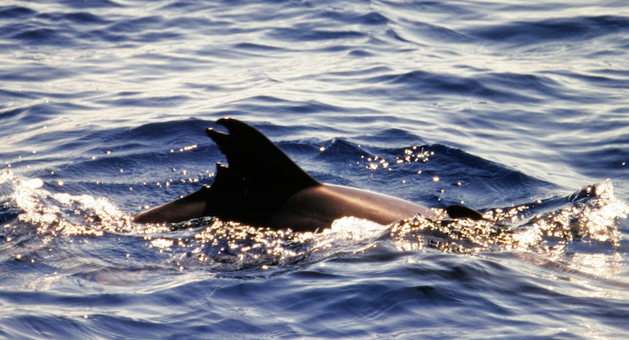
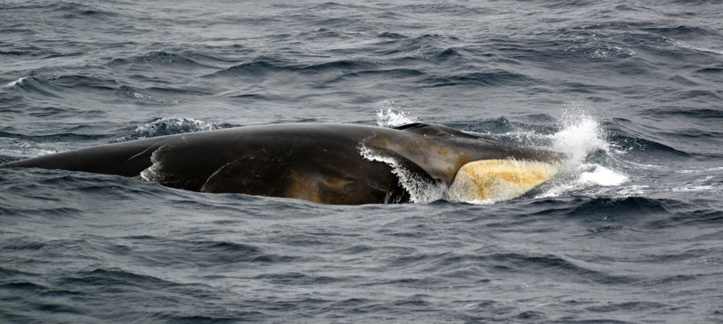
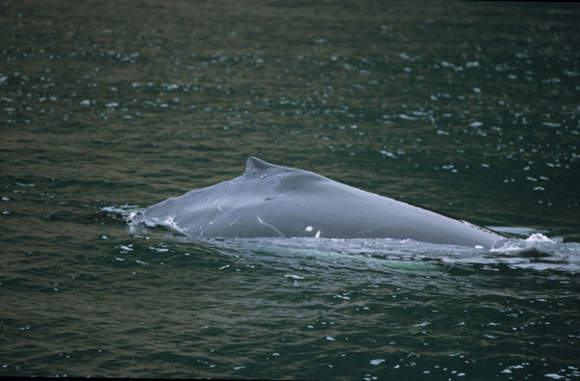
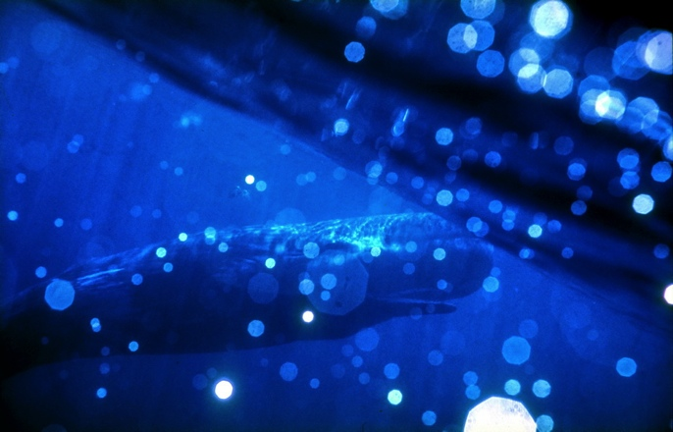
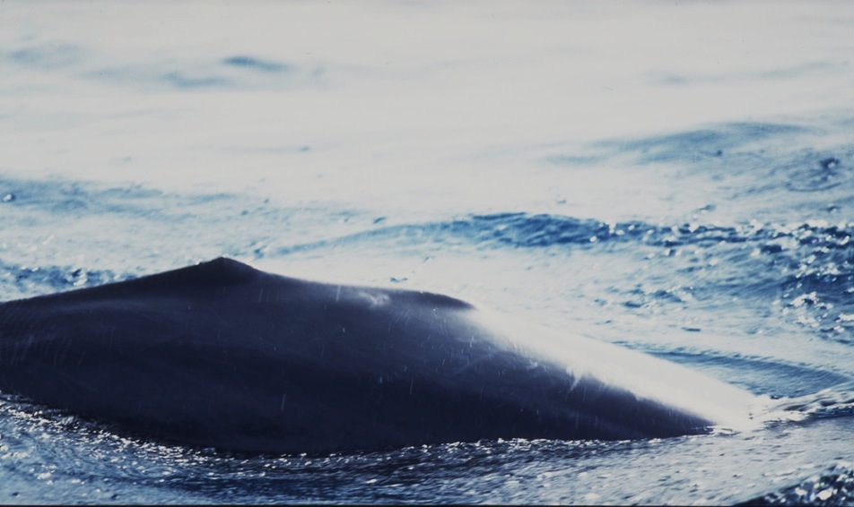
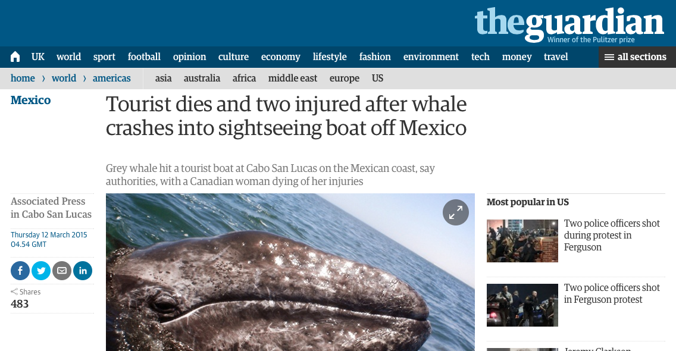
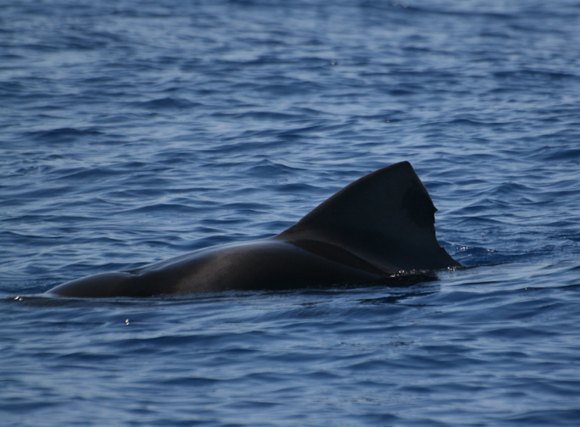
Species involved
Large whales
Small cetaceans
Cetacean images (except right whale): © MEER e.V.
© Walter Iwersen
© Samyo Jürgen Hoheisel
Introduction > Reasons & Causes > Mitigation Measures > IWC Data Base
Notes:
Which species are affected?
In principle every cetacean, be it a dolphin or a whale, can be hit. However, we know that certain species are especially vulnerable: namely those ones that are slow swimmers and/or stay for longer periods on the surface: such as right whales. As an example, 35% of North Atlantic right whale fatalities on the US East coast have been attributed to collisions and 20% of Southern right whales in South Africa die due to ship strikes.
In the Mediterranean Sea, collisions occur primarily with fin and sperm whales, while around Hawaii, numbers of collisions predominantly with humpbacks are rising - apparently as a result of their increasing abundance in that area.
In the Canary Islands sperm whales - another species spending prolonged periods of time on the surface - are threatened, with animals sometimes cut in half by large high speed ferries (no joke).
Small cetaceans are affected too, which is exemplified by these images involving dolphins and pilot whales in the Canary Islands.
And there is another species affected, that is us humans – as we know of several incidents where humans were injured, including some fatalities. A number of sailors have lost their boats as a consequence of running into a whale, and ferry passengers have been were injured. Hence we are talking about a human safety issue here, too.

Slide 5
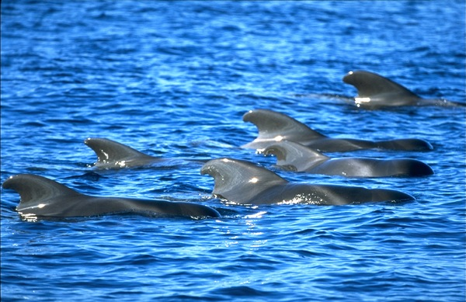
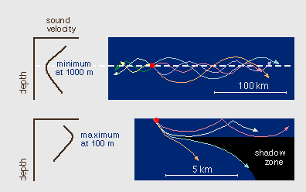
Knowledge ( & gaps )
Why do collisions occur?
BEHAVIOUR OF CETACEANS
How do whales react? Or: why don‘t they react?
Resting/sleeping
Distraction by other behaviours
Inter-species differences in responsiveness
Reaction related to age/sex class or individuals
Experience and learning
Background noise, hearing damage (TTS, PTS)
© F. Ritter / MEER e.V.
BEHAVIOUR OF SOUND IN WATER
Refraction, bending, absorption
Effects of bubbles, sound shadows, sound shielding
Lloyd Mirror Effect, near field effects
Cumulative noise from several sources
Introduction > Reasons & Causes > Mitigation Measures > IWC Data Base
Notes:
Why do collisions occur?
Cetaceans may be in a state of decreased alertness when resting. They might be distracted by hunting or feeding behaviours. Also, there will be interspecies differences or differences between age or sex classes, and even between individuals within a species. This in turn is related to experience & learning by individual animals.
Additionally, high levels of background noise or the fact that animals may suffer from hearing damage can make them less likely to detect approaching ships.
Looking at the propagation of sound in water, phenomena like refraction, bending and absorption of sound, as well as bubbles, sound shadows created in front of a vessel, the Lloyd mirror effect or near field effects may all play a role. This will lead to difficulties or even confusion about how to interpret vessel noise, i.e. knowing how far away and how fast a vessel is, which direction it comes from, etc.
And of course we thereby already imply that whales know to interpret certain types of noise as a danger, which simply might not be case either.

Slide 6
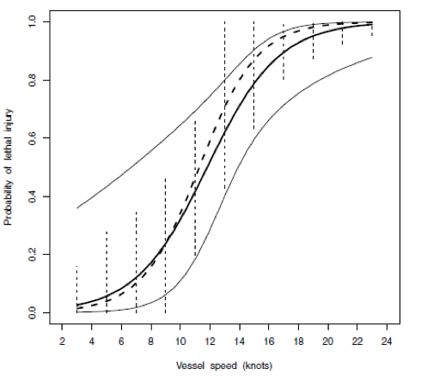
Vessel speed & size
Speed and size of vessel matter
The great majority of collisions leading to severe injury or death happened at
speeds of 14 knots or more
Most lethal or serious injuries are caused by large ships (80m length or more)
40 knots / whale at 600 m -> max. time for reaction = 30 seconds
Large vessels might not be able to manouevre
from Vanderlaan & Taggart (2007)
Introduction > Reasons & Causes > Mitigation Measures > IWC Data Base
Notes:
So there are still many unknowns.
We do know, however, that fatality and severity of injuries to whales are related to size and speed of vessels. The great majority of accounts when whales were severely hurt or killed occurred at speeds of 14 knots or more. This graph shows that from around 10 knots the probability of a lethal outcome for a whale increases sharply. Moreover, large ships cause most lethal and serious injuries.
As an extreme example think of a fast ferry travelling at 35-40 knots where the crew detects a whale 600 m in front of the bow: The remaining reaction time will be just about 30 seconds before the ship is where that whale was seen. So what do you do? This will be referred to again in a minute… (Slide 11)
And we have to keep in mind that larger vessels might not be able to freely navigate due to their size, the presence of other vessels or the fact that they are navigating in shallow or otherwise restricted waters.

Slide 7
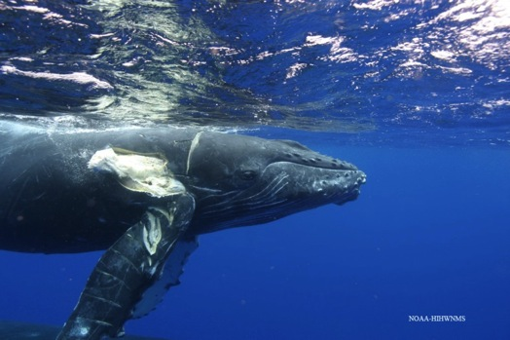
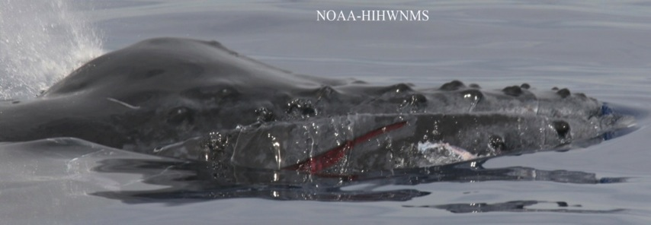
Knowledge Gaps
Collisions may go unnoticed
Injuries may not be identified at sea
Collisions (purposely) may not be reported
Animals may drift away and sink
In stranded animals, collision may not be properly identified
Dark number
???
Photos: Courtesy David Matilla © NOAA
Introduction > Reasons & Causes > Mitigation Measures > IWC Data Base
Notes:
The question heard most often is: How many ship strikes are there?
The honest answer is: We don‘t know!
Our knowledge gaps are a result of the fact that
> Collisions may not be recognised at all (as struck whales mostly will not stay on the bow)
> Injured animals may not be identified as such
> Dead animals often will drift way and sink to the bottom,
> and regarding stranded animals, the cause of death is not always unambiguously identifiable because you need expert knowledge to tell pre-mortem from post-mortem strikes, etc.
Hence we can be quite sure that there is probably quite a large dark number.

Slide 8
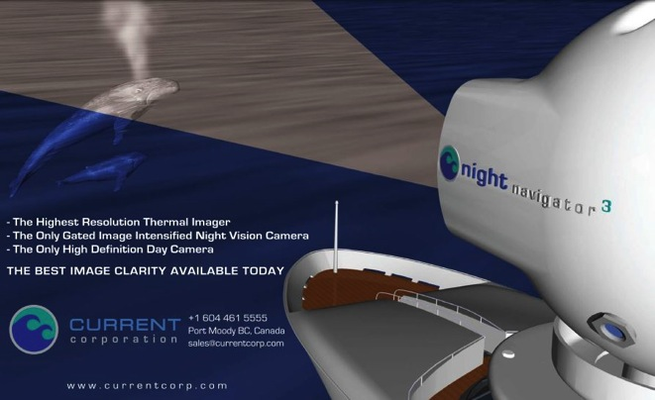
Mitigation: Technological Approaches
Technological mitigation measures
SONAR
Only short range, additional source of noise
Acoustic Warning Devices
Additional source of noise, effectiveness?
Propeller guards, etc.
Technical & economic constraints
Night vision / Infrared systems / Thermal imaging
Limited range/effectiveness under adverse conditions
Introduction > Reasons & Causes > Mitigation Measures > IWC Data Base
Notes:
There are three categories of mitigation measures: TECHNOLOGICAL, OPERATIONAL and EDUCATIONAL. Here is an overview:
TECHNOLOGICAL: Sonar will only be applicable within a very short range, and of course it introduces an additional source of noise into the marine environment. Actually, historically whalers used to use Sonar (Asdic) to bring whales to the surface, so such a measure could also cause more hits. The same applies to Acoustic Warning Devices (AWDs), where again nobody knows what type of warning sound would be an alerting signal for cetaceans, and even if that was the case, there easily might be effects like habituation.
Other systems have been developed include night vision, infrared or thermal imaging technologies but again efficacy will largely depend on the general conditions.

Slide 9
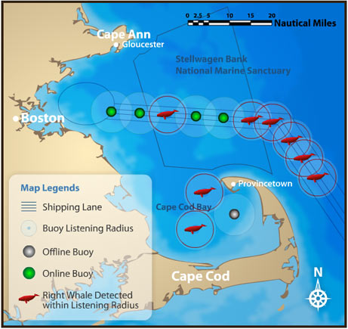
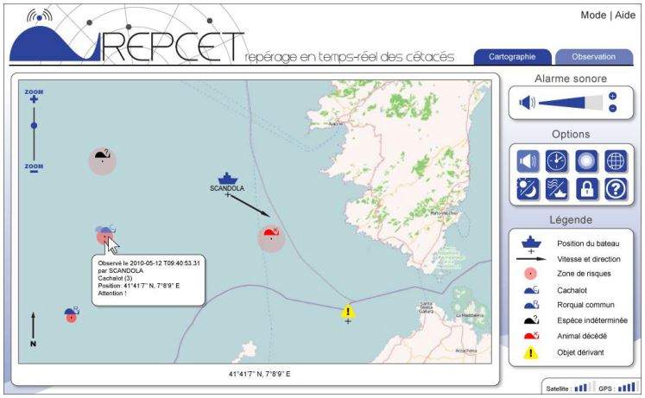
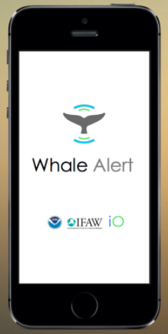
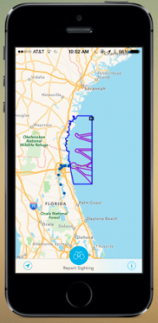
Mitigation: Technological Approaches
Alerting Tools
Passive acoustic monitoring off Boston (USA)
REPCET
Mediterranean Sea
Whale Alert APP
Onboard observers
Introduction > Reasons & Causes > Mitigation Measures > IWC Data Base
Notes:
As for measures that can be summarized as alerting tools, a famous example is the passive acoustic monitoring system off Boston (USA), involving a number of hydrophones where acoustical whale detections are broadcasted in real time to mariners in the area. No need to tell that this system involves large amounts of money which not always will be available elsewhere, e.g. in developing countries.
Another system is REPCET developed in the Mediterranean Sea where ship crews can inform each other about whale sightings via an online interface.
Recently the first mobile APP was developed which has a similar mode of operation.
Placing on-board observers is another option, especially as studies have revealed that observers are an effective means to detect whales in the path of a ship.
It has to be noted that the value of alerting tools may be limited given the unpredictable nature of whale movements, the dependence of observation on favourable (light, weather and sea state) conditions and the fact that they will strongly rely on crews and captains reacting in the right way. Hence, all these systems need proper testing before being considered as „true“ and effective mitigation tools.
As a conclusion: there is currently no technology known to effectively avoid collisions.

Slide 10
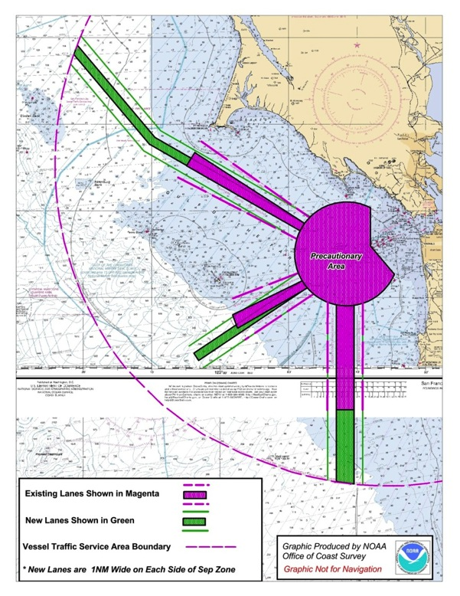
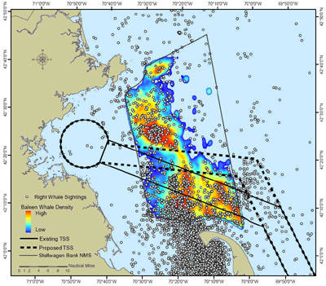
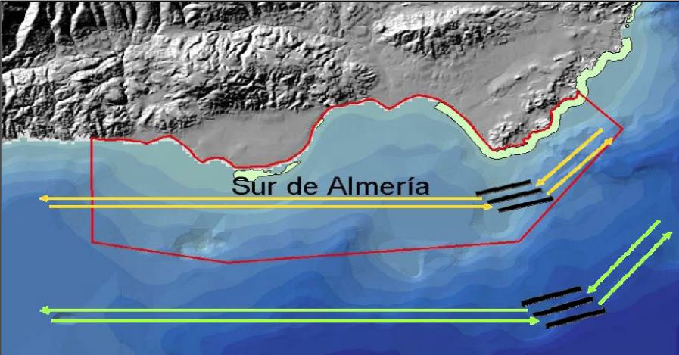
Mitigation: Operational Measures
Operational mitigation measures
Relocation of shipping lanes /
Traffic Separation Schemes
(IMO designation)
Introduction > Reasons & Causes > Mitigation Measures > IWC Data Base
Notes:
Looking now at possible OPERATIONAL mitigation measures: examples include the relocation of shipping lanes, such as the realignment of the Traffic Separation Schemes (TSS) servicing Boston, the ones implemented off San Francisco or in Southern Spain off Almeria, where the TSS was moved offshore away from an existing marine mammal protected area. These re-routing measures were implemented through the International Maritime Organisation (IMO).
Here, we need to consider a multi-species approach, as moving shipping routes offshore may lift the pressure from a more coastal species, but at the same time may create problems for others with a more pelagic distribution. Hence there is always a necessity that such measures are based on sufficient scientific data. And the process of implementation through large international organisations such as the IMO can sometimes be quite lengthy.

Slide 11
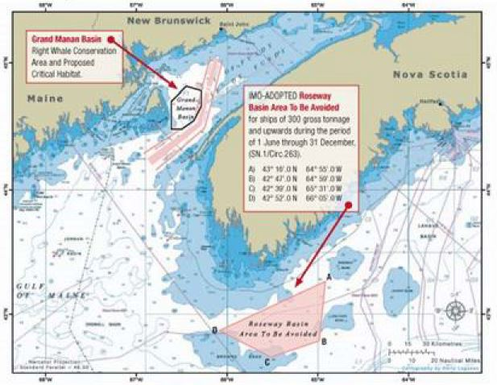
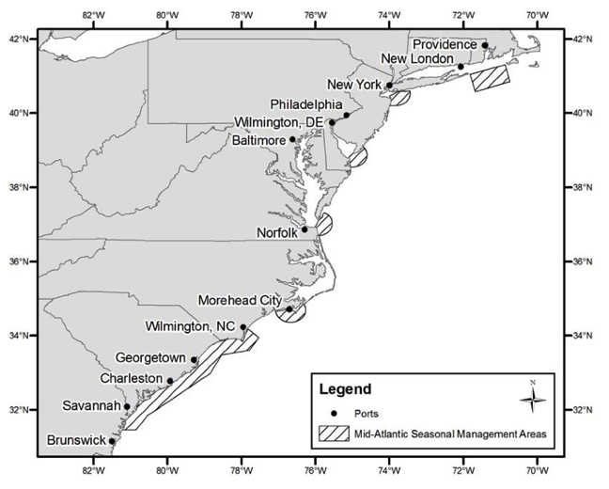
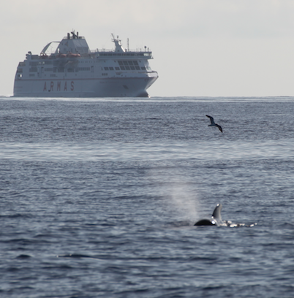
Mitigation: Operational Measures
Areas to be avoided, ATBAs
(IMO designation)
Recommended / mandatory
speed reductions
(e.g. Strait of Gibraltar, Alaska, East coast US )
Mandatory reporting
Avoidance manoeuvres (?)
© F. Ritter / MEER e.V.
Introduction > Reasons & Causes > Mitigation Measures > IWC Data Base
Notes:
Other operational measures include Areas To Be Avoided (ATBAs) off Nova Scotia in Canada, as well as voluntary & mandatory speed reductions introduced in the Strait of Gibraltar or in the Glacier National Park in Alaska. Off the east coast of the US, there are seasonal speed restrictions in place for North Atlantic right whales in accordance to their occurrence when migrating north or south. Here, all ships 65 ft or longer have to slow down to 10 knots in certain areas and during certain seasons.
Generally, mandatory reporting should be implemented wherever possible, ideally through strong legislation.
Common sense tells us that there should always be a possibility to initiate avoidance manoeuvres, but we know of countless cases of near misses even under good conditions, where the whale was seen well in advance and still there was no obvious option to avoid it.
As a skipper or captain, when you detect or are alerted to a whale, you will have to decide
>where to go so as to steer away from the animal
>about reducing speed which has consequences for manoeuvrability and sometimes passenger safety, or
>opt for doing nothing, relying on the whale to avoid the vessel.
These are no trivial questions and decisions, especially when there are only seconds to react.

Slide 12
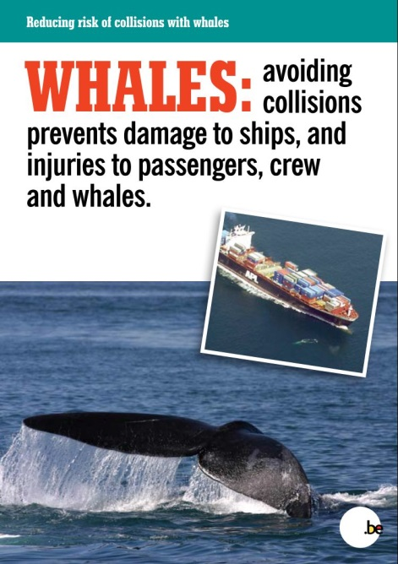
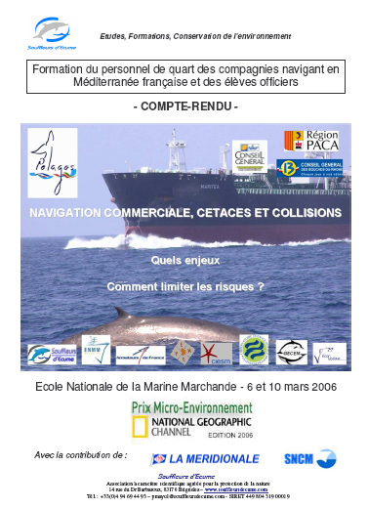
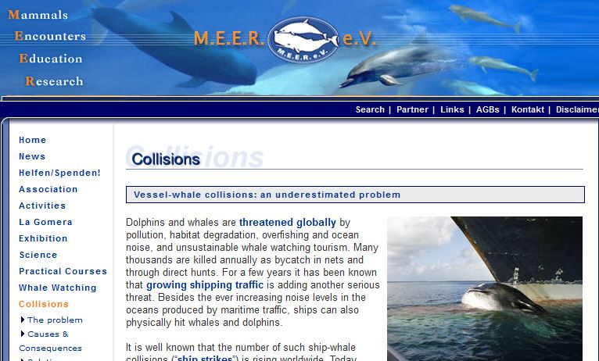
Mitigation: Educational Measures
Training & education resources
Courses, curricula at maritime schools
Websites / brochures / signposts, et al.
Introduction > Reasons & Causes > Mitigation Measures > IWC Data Base
Notes:
The third level of mitigation is EDUCATION.
Training for vessel personnel & crew is paramount, but knowledge about the issue must also be increased amongst managers and policy makers. Introduction of the issue into the curricula at navigational schools is equally important, and speed reductions can be noted on nautical maps.
Other tools to make people aware, including the general public, are websites, brochures and a leaflet produced by Belgium as a member state of the IWC in collaboration with the International Fund for Animal Welfare (IFAW).

Slide 13
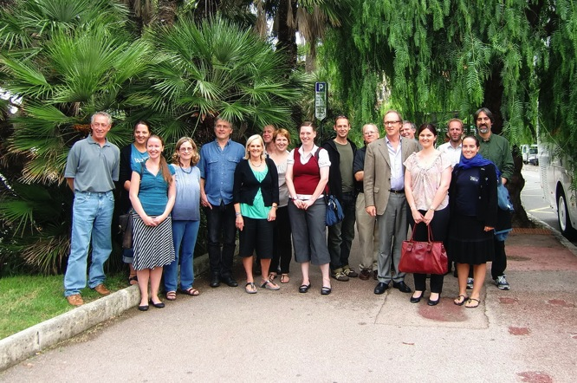
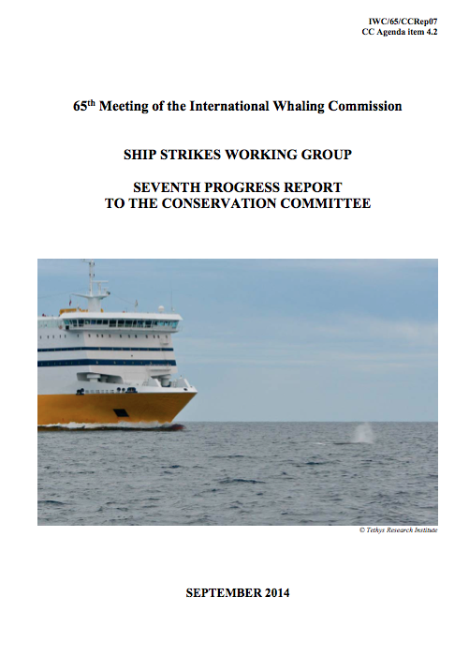
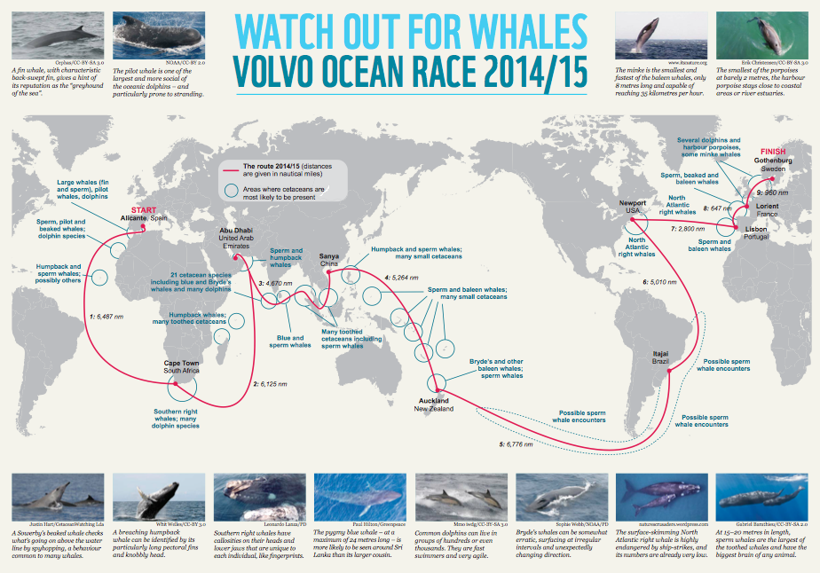
The Role of IWC
Ship Strike Working Group
Scientific Committee
International Workshops:
2010 – Beaulieu sur Mer (F)
2014 – Panama
Regular reports
Guidance documents
Collaborations
Introduction > Reasons & Causes > Mitigation Measures > IWC Data Base
Notes:
Let’s now have a look at the role of the International Whaling Commission. IWC has always been central in placing the issue high on the international agenda. As early as the 1990s, a dedicated Ship Strike Working Group was set up and in 2012 two ship strike data coordinators were appointed.
Under the leadership of member country Belgium the IWC has set up regular documentations monitoring the global situation, as well as international expert workshops. The relevant reports can be found on the organisation‘s website.
IWC is reaching out to the shipping industry to develop guidance documents, and in 2014 IWC had a very fruitful collaboration with WWF and the Volvo Ocean Race (VOR), a global regatta, where we highlighted especially sensitive areas along the planned route of that regatta (see map).

Slide 14
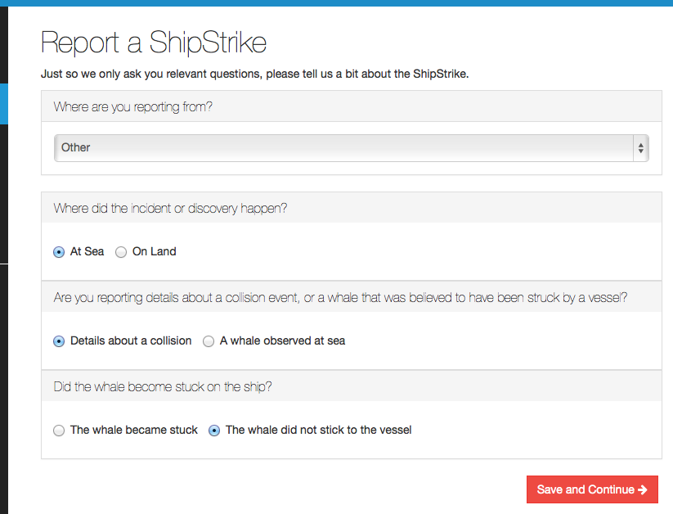
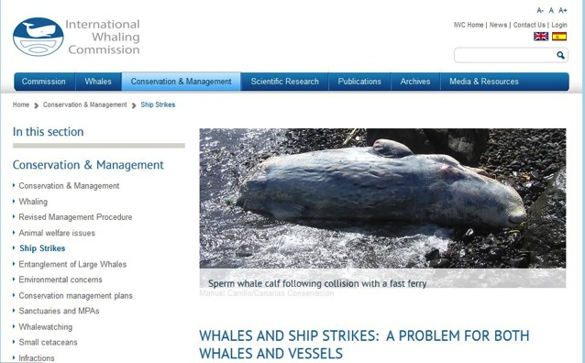
Reporting Collisions : The IWC Global Data Base
Reporting is essential !
IWC global ship strike data base
> 1,200 incidents
Numbers of reports increasing steadily
http://iwc.int/ship-strikes
Introduction > Reasons & Causes > Mitigation Measures > IWC Data Base
Notes:
This is one of the take-home-messages: Reporting is essential.
That‘s why the IWC has set up its global database on ship strikes, which went online in 2009, and which was modified, modernized and re-launched in 2015.
The database currently holds more than 1,200 incidents, both historical and recent, with numbers of reports increasing steadily. Please visit the IWC Website if you are searching for more information.
Most importantly: If you have witnessed a strike, if you found a dead animal with suspicious lesions, or if you were unlucky enough to have had a collision, go to the website and enter all the information you have. The database will guide you through the various questions in an interview style with an intuitive and interactive interface.

Slide 15
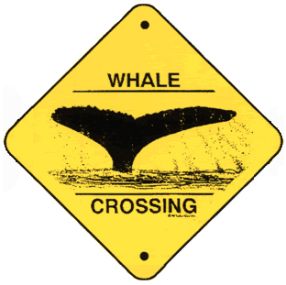
Recommendations
Separate vessels from whales
Reduce speed in whale areas
Place on-board observers
Train crew & personnel, inform yourself
Report to IWC data base: http://iwc.int/ship-strikes
Introduction > Reasons & Causes > Mitigation Measures > IWC Data Base
Notes:
To summarize, here is what IWC recommends:
Wherever possible, separate vessels from whales: A precondition will be the availability of sufficient data about abundance of cetaceans
Speed reduction…
The only mitigation measures known to date to be effective in reducing numbers of ship strikes re these two!
On-board observers are important - but note the limitations that have been mentioned
…as is the training of personnel
and of course to report collisions to the IWC data base
So if one would boil down this presentation into just two words, or, to phrase it differently:
If a whale would have a say, she would probably put it like this: (next slide)

Slide 16
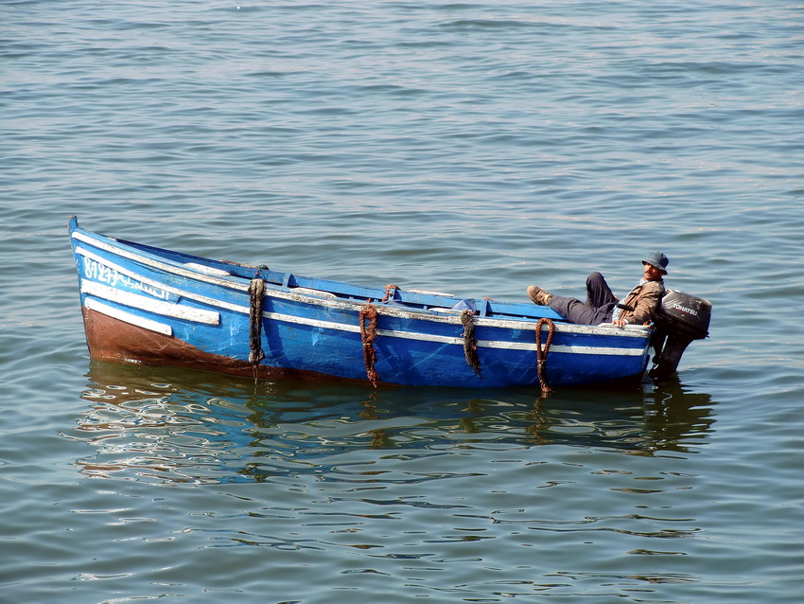
SLOW DOWN !!!
Thank You! Merci! Gracias! Grazie! Dankeschön!

